Slide 1
WEEK 9 · LECTURE 2 · HOUR 18
Evaluating Object Detectors
Mean Average Precision (mAP)
Deep Learning for Computer Vision
If you can't measure it precisely, you can't compare YOLO, SSD, and RetinaNet fairly.

Slide 2
RECAP · PREVIOUS LECTURE
Why We Need a Rigorous Metric
Last lecture: YOLO, SSD and RetinaNet all output a set of boxes, each with a class label and a confidence score
But how do we grade a detector's output?
Unlike classification, a detection can be right in class but wrong in location — or find some objects and miss others entirely
“Accuracy” doesn't even make sense here: there's no single right/wrong per image, just a set of boxes to compare against a set of ground-truth boxes
We need a metric that jointly captures localization quality AND classification quality, across every class and every confidence level
Today: build up to mAP, step by step
IoU
Precision
& Recall
PR
Curve
Average
Precision
mean AP
(mAP)
The gold standard: mAP is the metric used to report results in almost every detection paper and benchmark — PASCAL VOC, COCO, Open Images — and it's what lets you say “RetinaNet beats SSD” with a number behind it.
DEEP LEARNING FOR COMPUTER VISION | WEEK 9 · LECTURE 2 | HOUR 18
2

Slide 3
TODAY'S ROADMAP
Learning Objectives
01
Understand IoU and how it turns a predicted box into a right/wrong verdict against ground truth
02
Define precision and recall for detection, and see why a single threshold isn't enough
03
Construct a precision-recall curve and compute Average Precision (AP) from it
04
Understand how AP is averaged into mAP, and how mAP@0.5 differs from COCO's mAP@[.5:.95]
05
Know the pitfalls that make mAP numbers hard to compare across papers and datasets
DEEP LEARNING FOR COMPUTER VISION | WEEK 9 · LECTURE 2 | HOUR 18
3

Slide 4
BUILDING BLOCK 1
Intersection over Union (IoU)
IoU measures how well a predicted box overlaps the ground-truth box
IoU = Area of Overlap ÷ Area of Union
Ranges from 0 (no overlap) to 1 (perfect match)
This single number turns “how good is this box?” into something we can threshold and count
Ground Truth
overlap
Prediction
IoU = Area(overlap) / Area(union)
DEEP LEARNING FOR COMPUTER VISION | WEEK 9 · LECTURE 2 | HOUR 18
4

Slide 5
BUILDING BLOCK 2
From IoU to a Verdict: TP, FP, FN
Pick an IoU threshold (commonly 0.5) — this decides what counts as “close enough”
A prediction is a True Positive (TP) if:
  its class matches a ground-truth object, AND
  IoU with that ground truth ≥ threshold (and it's the best unclaimed match)
Otherwise it's a False Positive (FP)
Any ground-truth object left unmatched is a False Negative (FN)
Each ground-truth box can be matched at most once — duplicate detections of the same object count as FPs
True Positive (TP)
Predicted box matches a ground-truth object with IoU ≥ threshold
False Positive (FP)
Predicted box has no matching ground truth (wrong class, low IoU, or duplicate)
False Negative (FN)
A real object that no prediction matched
DEEP LEARNING FOR COMPUTER VISION | WEEK 9 · LECTURE 2 | HOUR 18
5

Slide 6
BUILDING BLOCK 3
Precision & Recall
Precision = TP / (TP + FP)
Recall = TP / (TP + FN)
“Of the boxes I predicted, how many were actually correct?”
“Of all the real objects out there, how many did I find?”
The trade-off:
High precision, low recall — a cautious detector that only fires when very confident, but misses many objects
Low precision, high recall — a trigger-happy detector that finds almost everything, but with lots of false alarms
Neither number alone tells the full story — a good detector needs both to be high across a range of thresholds
TOY EXAMPLE — ONE IMAGE, ONE CLASS
5 ground-truth objects. 6 predictions → 4 TP, 2 FP, 1 FN
Precision = 4/(4+2) = 0.67 Recall = 4/(4+1) = 0.80
DEEP LEARNING FOR COMPUTER VISION | WEEK 9 · LECTURE 2 | HOUR 18
6

Slide 7
BUILDING BLOCK 4
The Confidence Threshold Changes Everything
Detections ranked by confidence
Every detection comes with a confidence score — not just a box
Sort ALL detections (across the whole dataset) by confidence, highest first
Sweep a threshold down the ranked list:
  High threshold → only the most confident boxes counted → high precision, low recall
  Low threshold → nearly everything counted → low precision, high recall
This is exactly why we can't report “precision” or “recall” as one number — they depend entirely on where you set the threshold
0.95
TP
0.91
TP
0.88
FP
0.80
TP
0.75
FP
0.60
TP
0.44
FP
0.31
FP
Dashed line = an example threshold (0.78). Everything above it counts; everything below is discarded.
DEEP LEARNING FOR COMPUTER VISION | WEEK 9 · LECTURE 2 | HOUR 18
7

Slide 8
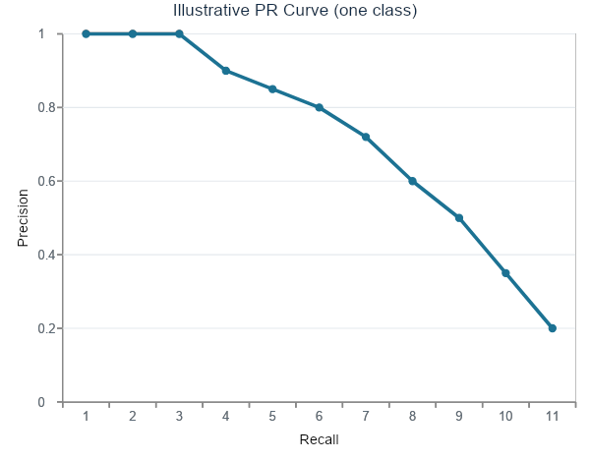
BUILDING BLOCK 5
The Precision-Recall Curve
Slide the confidence threshold from high to low, one detection at a time
At each point, compute cumulative precision and recall so far
Plotting these points traces the Precision-Recall (PR) curve for one class
As threshold drops:
  Recall only ever increases (we keep adding TPs and FNs become TPs)
  Precision tends to fall as more FPs get included, though it can wobble
A better detector traces a curve further toward the top-right corner
(illustrative shape, not a specific model's data)
DEEP LEARNING FOR COMPUTER VISION | WEEK 9 · LECTURE 2 | HOUR 18
8

Slide 9
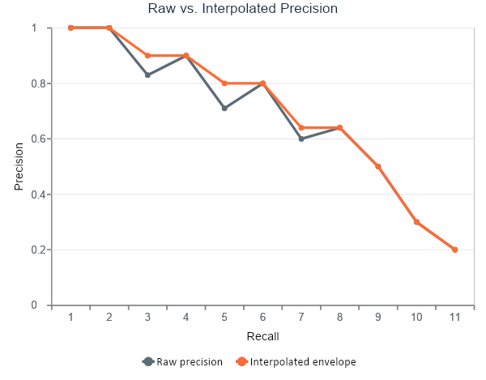
BUILDING BLOCK 6
Average Precision: Area Under the PR Curve
AP = the area under the precision-recall curve for one class
A single number that summarizes the whole curve — no need to pick one threshold
Raw PR curves are jagged (precision can go up as well as down), which makes “area under curve” ambiguous
Fix: interpolate precision before integrating
  p_interp(r) = the MAXIMUM precision found at any recall ≥ r
  This produces a smooth, monotonically non-increasing envelope
Two common conventions: 11-point interpolation (PASCAL VOC, classic) and all-point / 101-point interpolation (modern VOC, COCO)
DEEP LEARNING FOR COMPUTER VISION | WEEK 9 · LECTURE 2 | HOUR 18
9

Slide 10
WORKED EXAMPLE — PART 1
Ranking Detections & Counting TP / FP
Setting: one class (“car”), 5 ground-truth objects in the test set
6 detections total, ranked by confidence, highest first
For each rank, we track the running (cumulative) count of TPs and FPs
Cumulative precision = cumTP / (cumTP + cumFP)
Cumulative recall = cumTP / total ground truth (5)
Rank
Conf.
TP/FP
cumTP
cumFP
Prec.
Recall
1
0.95
TP
1
0
1.00
0.20
2
0.91
TP
2
0
1.00
0.40
3
0.88
FP
2
1
0.67
0.40
4
0.80
TP
3
1
0.75
0.60
5
0.75
FP
3
2
0.60
0.60
6
0.60
TP
4
2
0.67
0.80
Only 4 of 5 ground-truth cars were ever detected → the 5th is a False Negative; recall tops out at 0.80
DEEP LEARNING FOR COMPUTER VISION | WEEK 9 · LECTURE 2 | HOUR 18
10

Slide 11
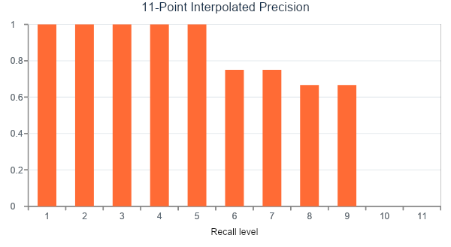
WORKED EXAMPLE — PART 2
Interpolating & Computing AP
Take the (recall, precision) pairs from the table and interpolate at 11 recall levels (0.0, 0.1, …, 1.0)
At each level, use the max precision seen at that recall or higher
Recall never reached 0.9 or 1.0 in our example → interpolated precision there is 0
AP = average of the 11 interpolated precision values
AP = (1+1+1+1+1+.75+.75+.667+.667+0+0) / 11 = 0.712
DEEP LEARNING FOR COMPUTER VISION | WEEK 9 · LECTURE 2 | HOUR 18
11

Slide 12
PUTTING AP TOGETHER
From AP to mAP: Averaging Across Classes
AP is computed separately for every class (car, person, dog, …) — each gets its own precision-recall curve and its own AP
mAP = the mean of the AP values across all classes
This single number summarizes detector performance across the entire label set, not just one object type
A detector can have wildly different AP per class (e.g. great at “person”, poor at “umbrella”) — mAP hides that unless you look at the per-class breakdown too
Car
0.71
Person
0.85
Dog
0.63
Bicycle
0.58
Traffic Light
0.41
mAP = average(0.712, 0.85, 0.63, 0.58, 0.41) = 0.636
DEEP LEARNING FOR COMPUTER VISION | WEEK 9 · LECTURE 2 | HOUR 18
12

Slide 13
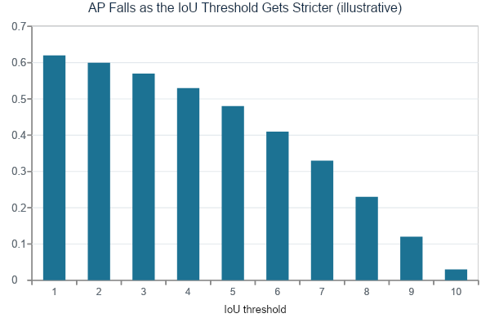
REFINING THE METRIC
mAP @ IoU Threshold
Everything so far assumed ONE fixed IoU threshold (e.g. 0.5) for deciding TP vs FP
mAP@0.5
  lenient; a loosely-placed box still counts
mAP@0.75
  strict; demands tight, accurate localization
mAP@[.5:.95]
  COCO's primary metric: average mAP over 10 thresholds (0.50, 0.55, …, 0.95)
Averaging over many thresholds rewards detectors that are both correct AND precisely localized — harder to game than a single loose threshold
mAP@[.5:.95] = average of the 10 bars above — a single, harder-to-game headline number.
DEEP LEARNING FOR COMPUTER VISION | WEEK 9 · LECTURE 2 | HOUR 18
13

Slide 14
TWO CONVENTIONS
PASCAL VOC vs. COCO mAP
PASCAL VOC (2007)
PASCAL VOC (2010+)
MS COCO
IoU threshold(s)
0.5 only
0.5 only
0.50–0.95, step 0.05 (10 thresholds)
Interpolation
11-point
All-point (exact AUC)
101-point
Headline metric
mAP@0.5
mAP@0.5
mAP@[.5:.95] (often just “AP”)
Object size breakdown
No
No
Yes — APS / APM / APL
Typically reported today?
Rarely (historical)
Sometimes, as “mAP@0.5”
Yes — the modern default
Rule of thumb: if a paper just says “mAP” with no other context, check which dataset/protocol it's reporting — the numbers are NOT directly comparable across conventions.
DEEP LEARNING FOR COMPUTER VISION | WEEK 9 · LECTURE 2 | HOUR 18
14

Slide 15
REFINING THE METRIC
Beyond mAP: COCO's Extra Metrics
A single mAP number can't tell you WHERE a detector struggles
COCO's evaluation reports a whole family of metrics alongside the headline AP
Useful for diagnosing a detector before you deploy it — e.g. is it specifically weak on small objects?
AP
Primary metric: mean AP averaged over IoU 0.50–0.95
AP50 / AP75
AP at a single fixed IoU threshold (0.5 or 0.75)
AP-small / medium / large
AP restricted to objects of that pixel-area range — small objects are notoriously hard
AR@1 / @10 / @100
Average Recall given a max number of detections allowed per image
DEEP LEARNING FOR COMPUTER VISION | WEEK 9 · LECTURE 2 | HOUR 18
15

Slide 16
READING MAP CRITICALLY
Common Pitfalls When Comparing mAP
01
Different datasets: COCO mAP and VOC mAP are not the same scale — COCO's stricter, multi-threshold protocol always looks lower for the same detector
02
Different input resolution: The same architecture scores higher at 800px input than at 320px — always check what resolution a reported number used
03
Different backbones: “SSD” with a ResNet-101 backbone and “SSD” with a MobileNet backbone are not comparable, even though both are “SSD”
04
Test set leakage / tuning: Repeatedly tuning on the test set (instead of a held-out validation set) inflates reported mAP
05
Cherry-picked thresholds: A paper reporting only mAP@0.5 may be hiding poor localization precision that mAP@0.75 would expose
DEEP LEARNING FOR COMPUTER VISION | WEEK 9 · LECTURE 2 | HOUR 18
16

Slide 17
CONNECTING THE DOTS
mAP Isn't the Whole Story — Report Speed Too
Recall last lecture's speed-accuracy trade-off: a higher-mAP model can be useless if it can't hit your deployment's frame-rate budget
Always report mAP alongside:
  Inference speed (FPS) or latency (ms/image)
  Hardware used (GPU model, batch size) — speed numbers aren't portable across hardware
  Model size (parameters, FLOPs) — relevant for edge/mobile deployment
A detector's “best” isn't a single number — it's the best mAP achievable inside YOUR constraints
mAP
the sweet spot for most deployments
Faster R-CNN
RetinaNet
SSD
YOLO
Speed (FPS) →
DEEP LEARNING FOR COMPUTER VISION | WEEK 9 · LECTURE 2 | HOUR 18
17

Slide 18
PUTTING IT TOGETHER
Revisiting YOLO, SSD & RetinaNet — by the Numbers
YOLOv3
SSD300
RetinaNet (R101-FPN)
Dataset / protocol
COCO test-dev
COCO test-dev
COCO test-dev
AP (mAP@[.5:.95])
~33.0
~25.1
~39.1
AP50
~57.9
~43.1
~59.1
Speed (approx.)
~20–30 FPS
~45–59 FPS
~5 FPS
The pattern holds: RetinaNet's Focal Loss + FPN buys real accuracy, at a real speed cost. SSD trades accuracy for speed. YOLOv3 sits in between. mAP is what lets us say this precisely instead of by feel.
Figures are commonly cited approximate values from the original papers / COCO leaderboard history — illustrative, not a live benchmark.
DEEP LEARNING FOR COMPUTER VISION | WEEK 9 · LECTURE 2 | HOUR 18
18

Slide 19
IN PRACTICE
Computing mAP Without Doing It By Hand
In practice, nobody computes AP by hand — standard tooling exists and should be used for any real evaluation
pycocotools
  the reference implementation for COCO-style AP/AR; most detection frameworks wrap it
torchmetrics.detection.MeanAveragePrecision
  a PyTorch-native option for training-loop evaluation
VOC-style eval scripts
  still used for legacy PASCAL-format benchmarks
What matters is understanding what the number means — today's lecture — so you can sanity-check the tool's output
Run the detector on the test set → save all predicted boxes + scores + classes
1
Load ground-truth annotations for the same images
2
For each class, match predictions to ground truth via IoU, rank by confidence
3
Compute the precision-recall curve → interpolate → integrate to get AP
4
Average AP across classes (and across IoU thresholds, if using COCO protocol) → mAP
5
DEEP LEARNING FOR COMPUTER VISION | WEEK 9 · LECTURE 2 | HOUR 18
19

Slide 20
WRAP-UP
Key Takeaways
01
IoU turns box overlap into a number; a threshold turns that number into TP / FP / FN
02
Precision and recall each tell half the story — neither alone grades a detector fairly
03
AP = area under the interpolated precision-recall curve for one class; mAP = its average across all classes
04
COCO's mAP@[.5:.95] is stricter and more informative than VOC's mAP@0.5 — know which one you're reading
05
Always read mAP next to speed, resolution, and hardware — a number in isolation can mislead
Next: Week 10 — Image Segmentation — from bounding boxes to pixel-level predictions.
DEEP LEARNING FOR COMPUTER VISION | WEEK 9 · LECTURE 2 | HOUR 18
20

